Slide 1
Update 6/30/2022

Slide 2
Methods
Decision Tree, Random Forest, Quadratic Discriminant Analysis

Slide 3
Results paper’s 15 features DDOS merged
Decision Tree: 97.95% time = 0.13 seconds
Random Forest: 97.95% time = 4.82 seconds
QDA: 91.67% time = 0.095 seconds
Features: duration, protocol type, service type, flag, src_bytes, dst_bytes, land, wrong_fragment, logged_in, count, Srv_count, dst host count, dst host srv count, dst host same source port rate

Slide 4
Confusion Matrix
Decision Tree:
array([[11385, 518],
[ 671, 45512]])
Random Forest:
array([[11378, 515],
[ 678, 45515]])
QDA:
array([[11896 4678]
[ 160 41352]])

Slide 5
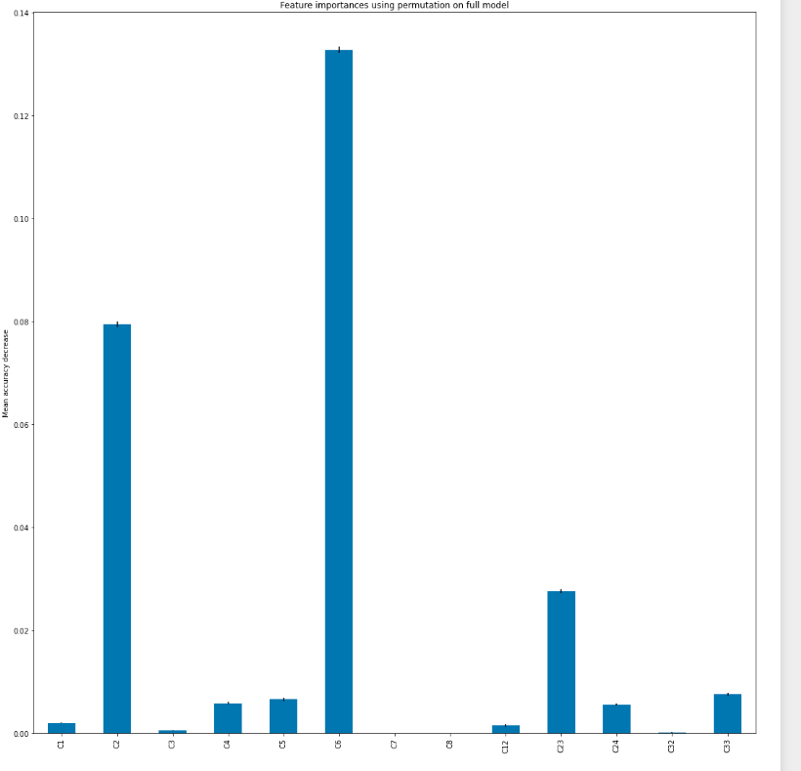
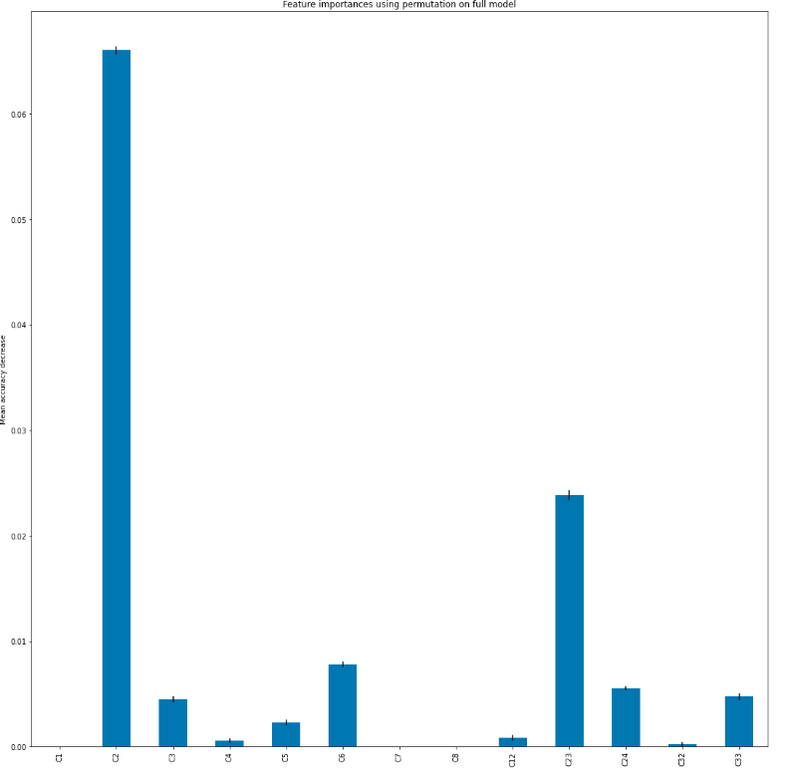
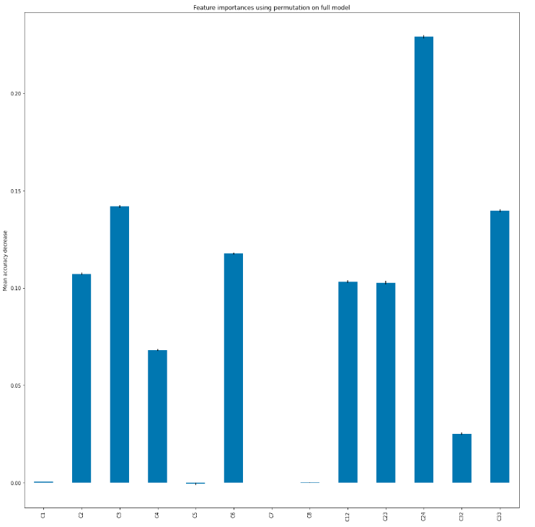
Feature Importance
Decision Tree
Random Forest
QDA
Random Forest

Slide 6
Results paper’s top 3 features plus DDOS merge
Decision Tree: 97.80% time = 0.056 seconds
Random Forest: 97.81% time = 4.39 seconds
QDA: 95.69% time = 0.040 seconds
Features: protocol type, dst_bytes, count

Slide 7
Confusion Matrix
Decision Tree:
array([[11196, 416],
[ 860, 45614]])
Random Forest:
array([[11197, 412],
[ 859, 45618]])
QDA:
array([[11095, 1542],
[ 961, 44488]])

Slide 8
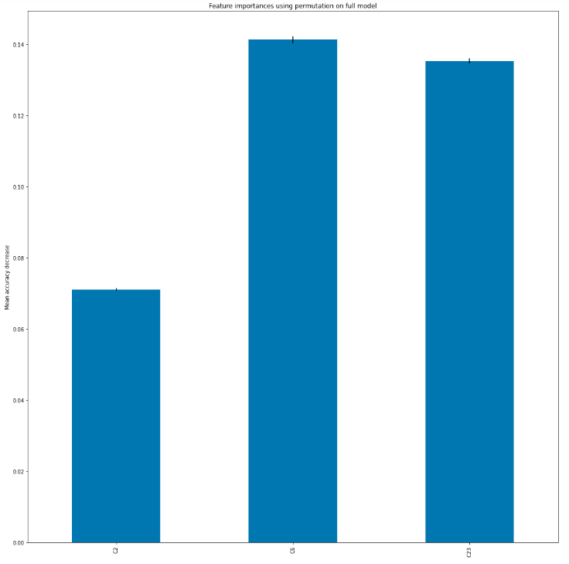
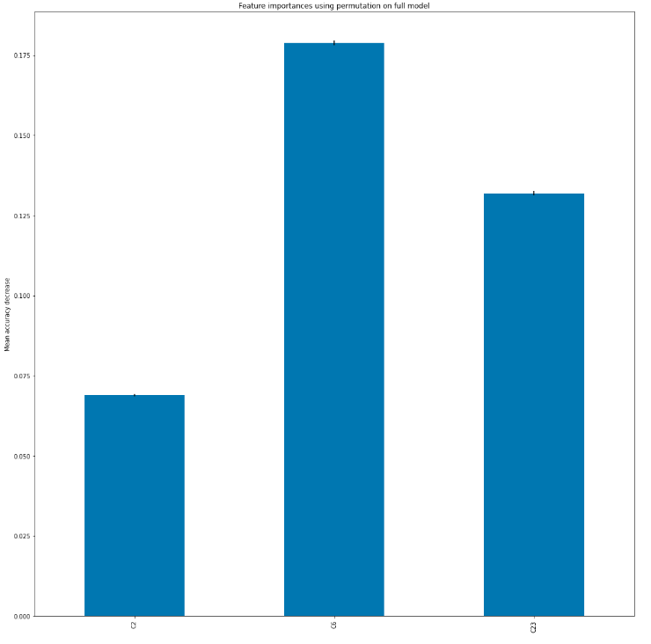
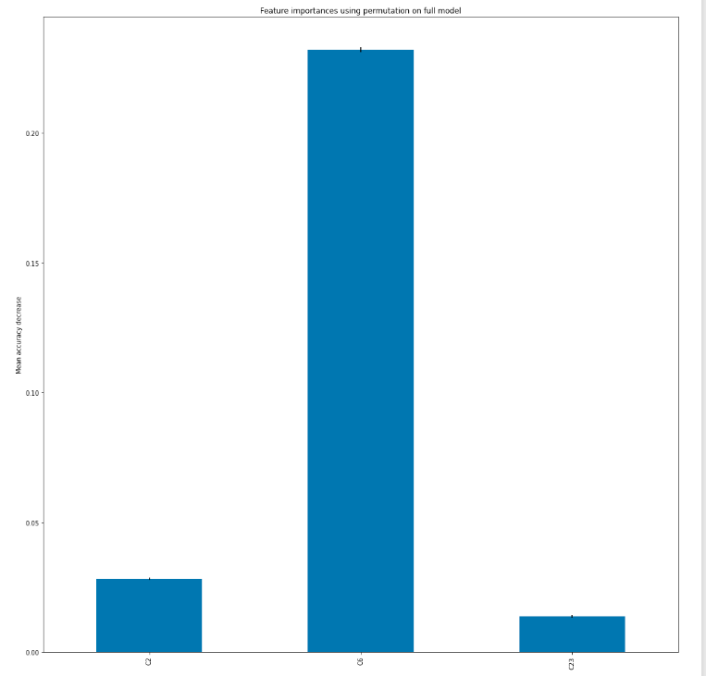
Feature Importance
Decision Tree
Random Forest
QDA
Random Forest

